Slide 1
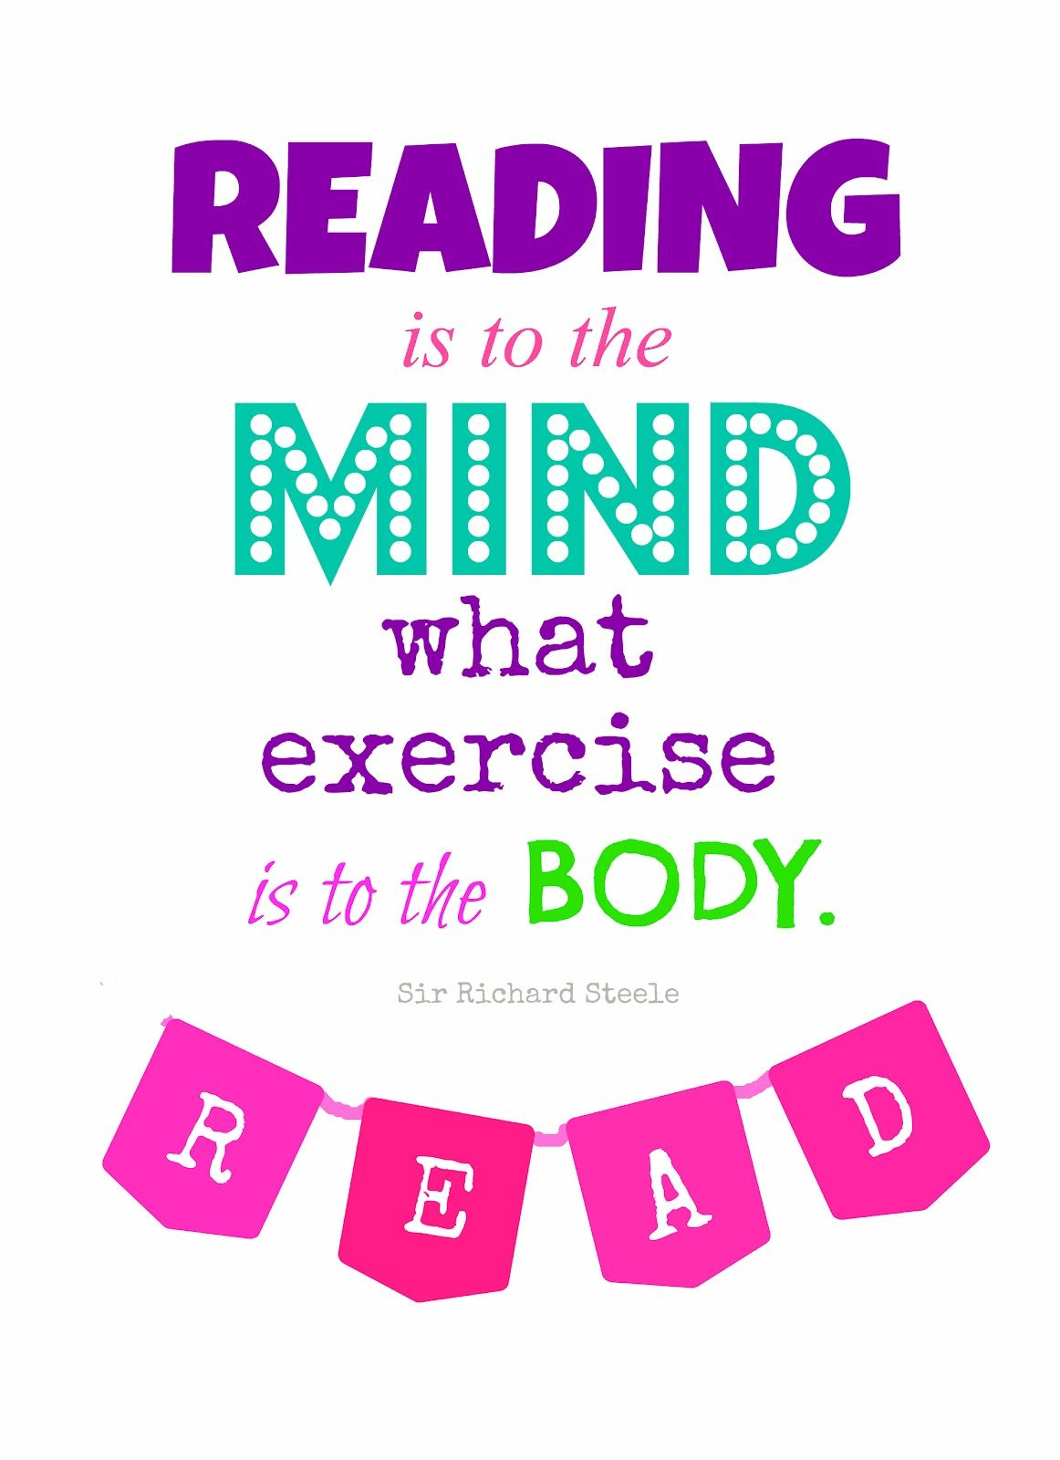

Slide 2
Rapid Read: Instructions
Read the short text provided
Use a dictionary to define any words you are unsure of
Select the question set for you (Good/ Better/ Excellent).
Answer your set of questions
Tell someone else about what you have read/ done
Would you like to push yourself a little further?
Why not conduct some research into the author of Jane Eyre (Charlotte Bronte) and then create a short fact file about her?

Slide 3
The text

Slide 4
The questions
GOOD

Slide 5
The questions
BETTER

Slide 6
The questions
EXCELLENT

