Slide 1
FLASH FICTION WRITING
Flash fiction simply means a very short story rather than a novel.
On each slide, there is a picture and two writing tasks for you to choose from.
(Or if you’re really ambitious you could try both tasks!)
There are some creative writing reminders on the first few slides.
So, why not check those out before beginning to write?

Slide 2
Creative writing reminder: #1 Plan before you write! You could use a story arc or a 5 minute story plan (printable copies on the next slide)

Slide 3
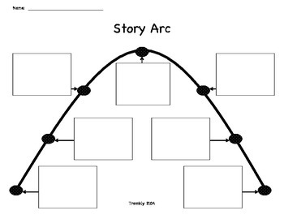
Notes:
Print out

Slide 4
5 min story plan
What happens?
Task: complete the story plan, thinking about the important parts of a story
Character List
Setting:
Where is your story set?
Which year/time period?
Who will tell your story?
For excellent stories:
Include a range of ambitious vocabulary and original descriptions (no clichés!)
(You could include 5 senses, similes, metaphors etc…)

Slide 5
Creative writing reminder: #2 be creative with your words and phrases
Use a dictionary or thesaurus to help you find the best words
Try to paint a picture with your words by using:
Similes/metaphors
The 5 senses
Unusual adjectives and verbs

Slide 6
Creative writing reminder: #3 make it believable
The people reading your writing want to imagine being there too, so you need to make it believable for them
Use objects/places/transport that are familiar to us
The things that happen to your main character should be realistic
Use your imagination!

Slide 7
Now, let’s see how creative you can be!
On each slide, there is a picture and two writing tasks
for you to choose from.
Or, if you’re really ambitious, you could try both
tasks!

Slide 8
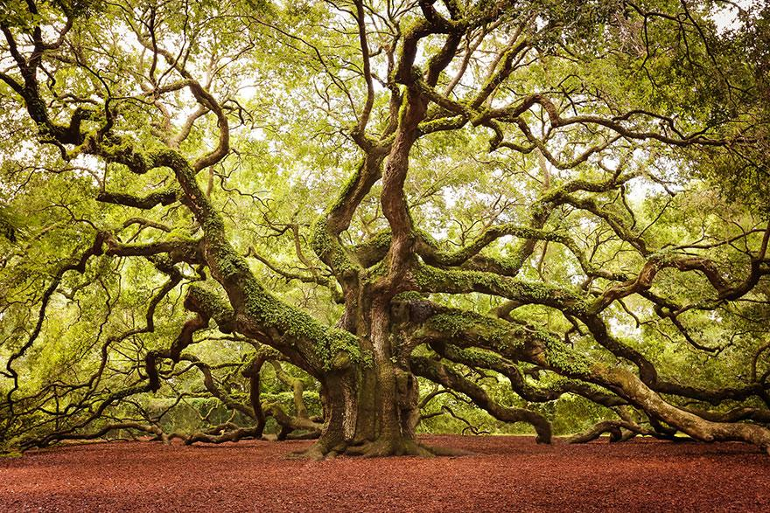
1. Look carefully at the picture and then describe the tree in no more than 50 words. (try to use a simile or a metaphor in your writing ) Or 2. Write a 200 word story with the title: The Magic Tree (remember to plan your ideas first…)

